Slide 1

Used car
Price Prediction

Slide 2
Problem Statement
With the covid 19 impact in the market, lot of changes are observed in the car market. Now some cars are in demand hence making them costly and some are not in demand hence cheaper. Small traders, who sell used cars, with the change in market due to covid 19 impact, are facing problems with their previous car price valuation machine learning models. So, need to build a new machine learning models from new data. I have to make car price valuation model. This project contains two phase-
Data Collection Phase : I have to scrape at least 5000 used cars data. I can scrape more data as well, it’s up to me. I need to scrape the data of used cars from websites (Olx, cardekho, Cars24 etc.). I have to fetch data for different locations. The number of columns for data doesn’t have limit. Generally, these columns are Brand, model, variant, manufacturing year, driven kilometers, fuel, number of owners, location and at last target variable Price of the car. I can make changes to it, i can add or remove some columns, it completely depends on the website from which I am fetching the data.
Continued……………

Slide 3
Model Building Phase: After collecting the data, I need to build a machine learning model. Before model building I have to do all data pre-processing steps. Try different models with different hyper parameters and select the best model.
Steps that are Include:
1. Data Cleaning
2. Exploratory Data Analysis
3. Data Pre-processing
4. Model Building
5. Model Evaluation
6. Selecting the best model

Slide 4
About Dataset
Initially, there are 5545 rows and 7 columns in the dataset.
There are 6 columns which are of object type.
There is 1 column which is of int type.
‘Unwanted : 0’ contains index however data frame has their own index. So, drop it.
After data cleaning there are 5545 rows and 9 columns in the dataset.
There are 2 columns which are of int type.
There are 7 columns which are of object type.
There is no null values in the dataset.
'Transmission_Type’ column has 89 value for which Transmission_Type is not defined. So, I replace it with 'Not Defined'.

Slide 5
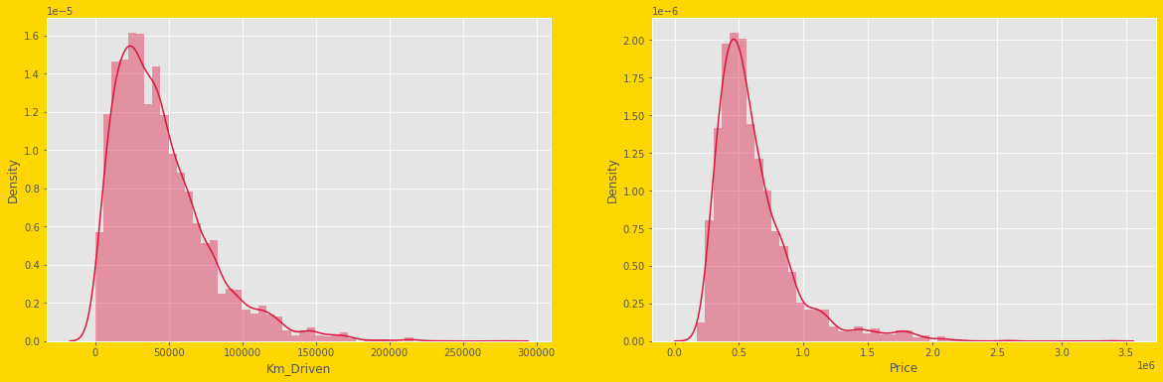
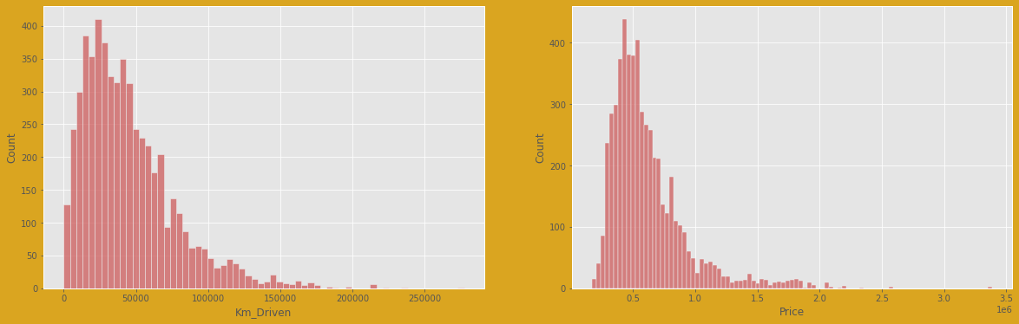
Exploratory Data Analysis
a).Univariate Analysis:

Slide 6
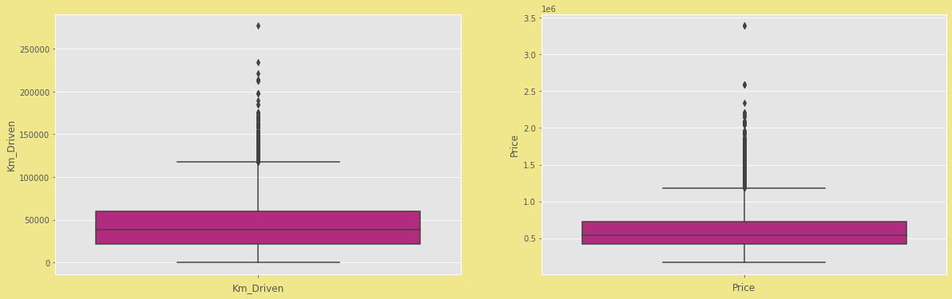
From these graph, it is observed that data is not normally distributed.
There is skewness in the dataset.
Outliers are also present in the dataset.

Slide 7
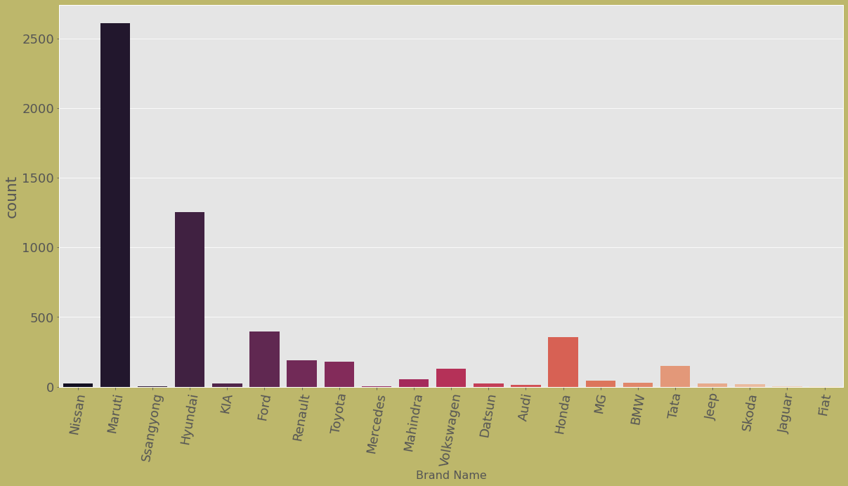
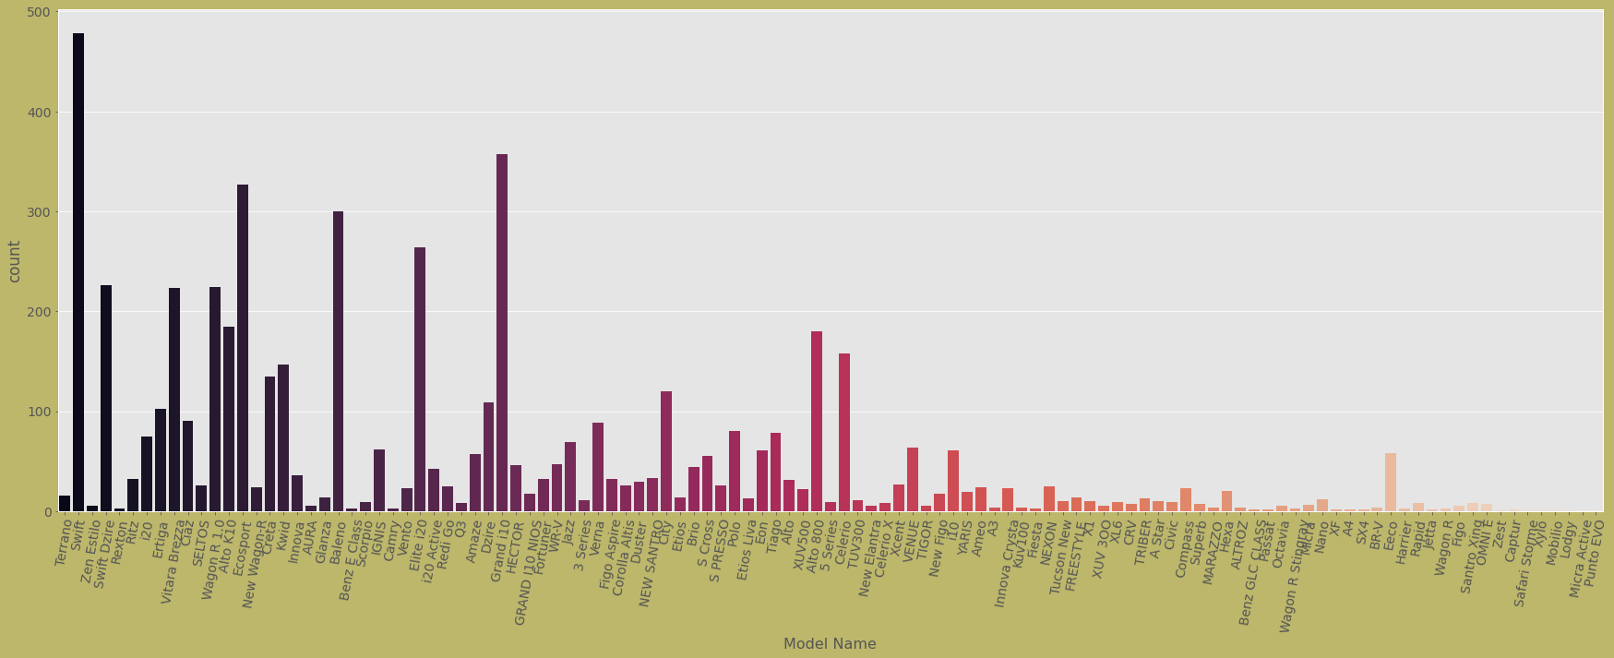
Most available cars are of ‘Maruti’, followed by ‘Hyundai’.
Most available model are ‘Swift’ of ‘Maruti’, followed by ‘Grand i10’ of ‘Hyundai’.

Slide 8
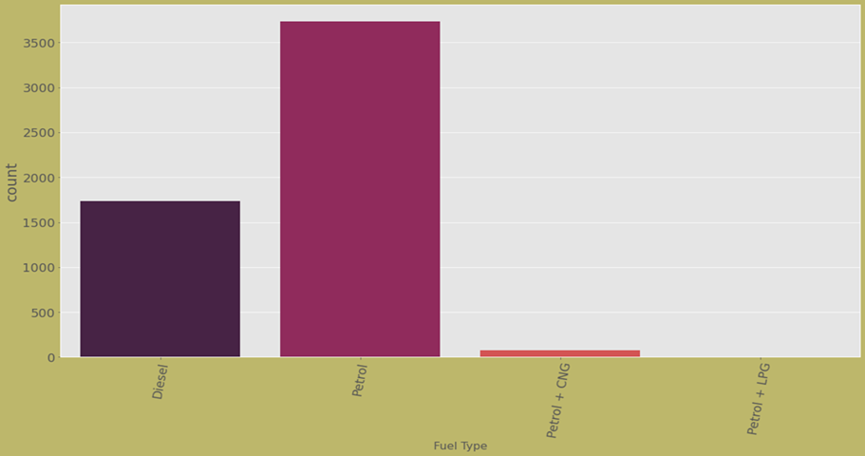
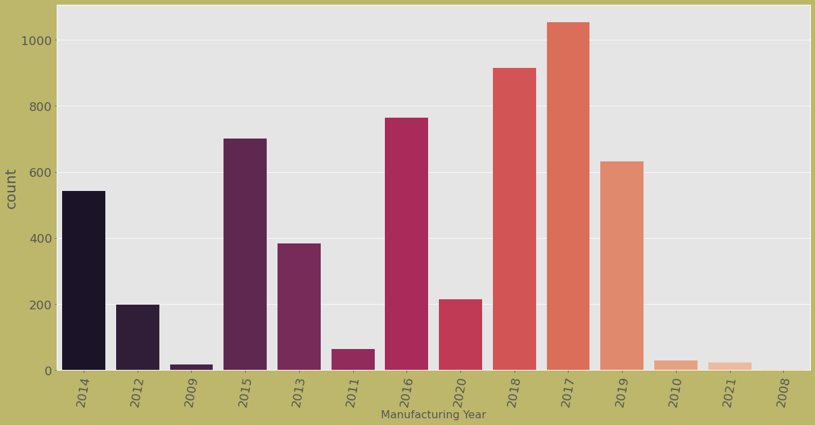
Mostly have fuel type as ‘Petrol’.
The cars that have ‘Manufacturing Year’ as 2017 are most in counting, followed by 2018.

Slide 9
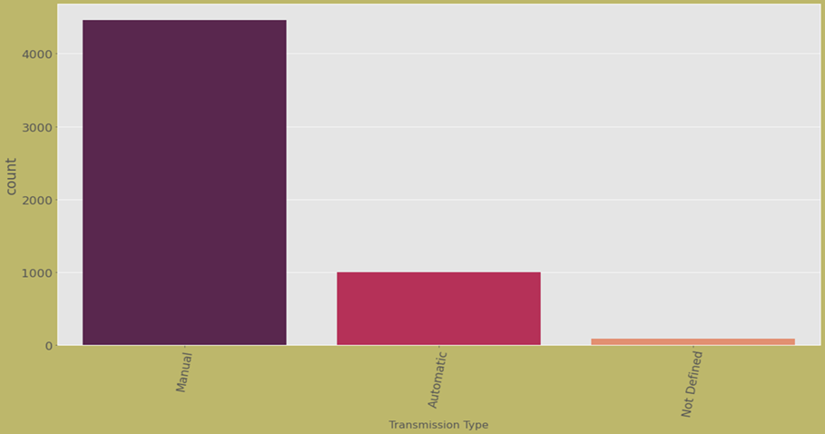
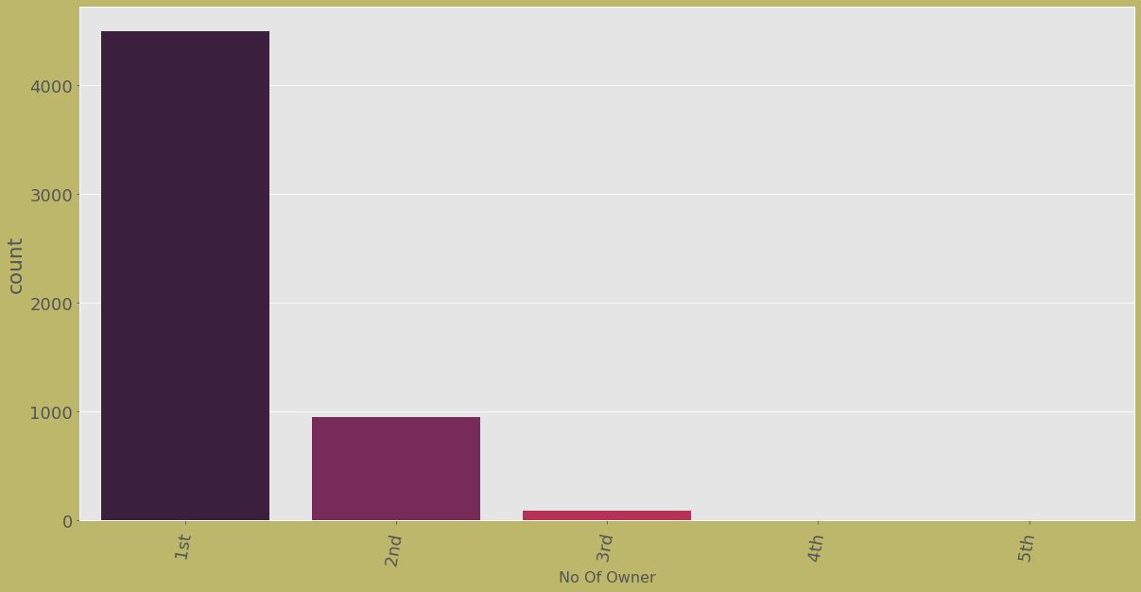
‘Transmission Type’ as ‘Manual’ are most.
Mostly available cars have 1st owner as No_Of_Owner.

Slide 10
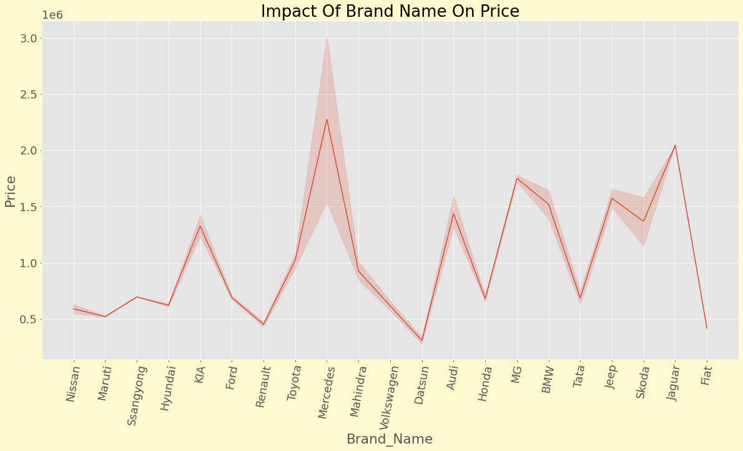
b).bivariate Analysis:
‘Mercedes’ cars are expensive, followed by ‘Jaguar’.

Slide 11
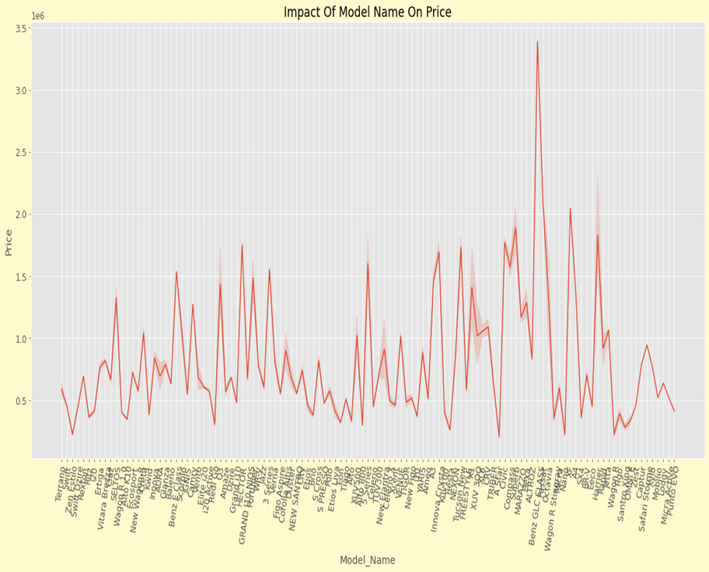
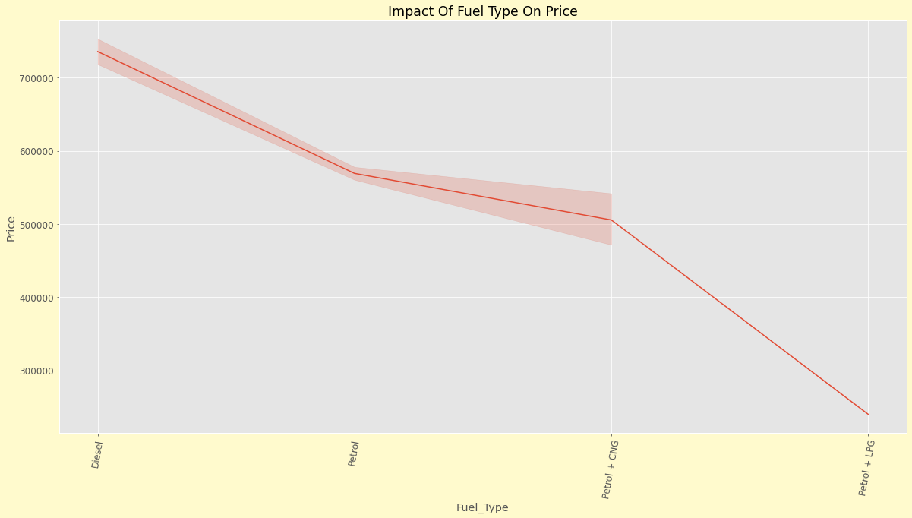
‘Benz GLC Class’ of ‘Mercedes’ are the most expensive car in the dataset.
‘Diesel’ as ‘fuel_Type’ cars are costly.

Slide 12
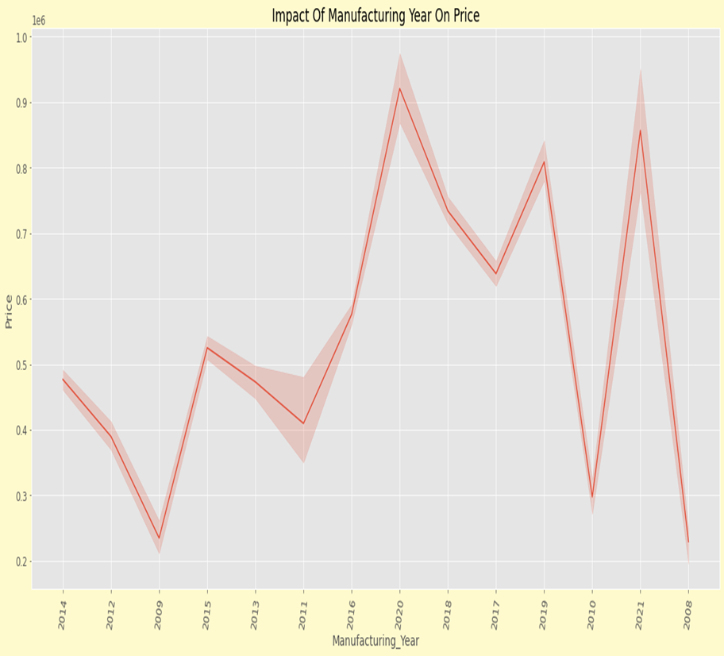
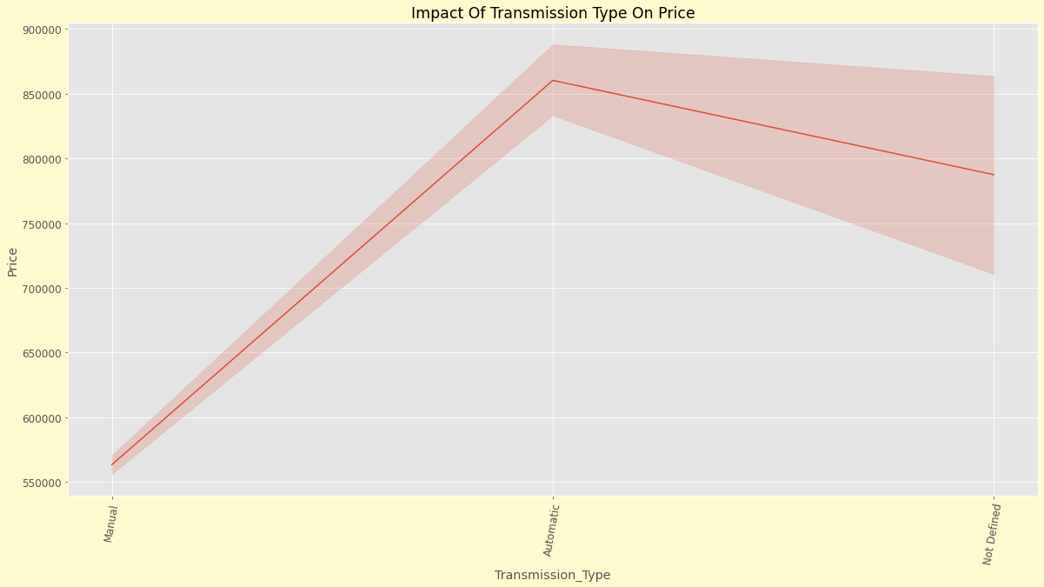
‘Price’ are high when ‘Manufacturing Year’ is 2020, followed by 2021.
‘Automatic’ as ‘Transmission_Type are expensive.

Slide 13
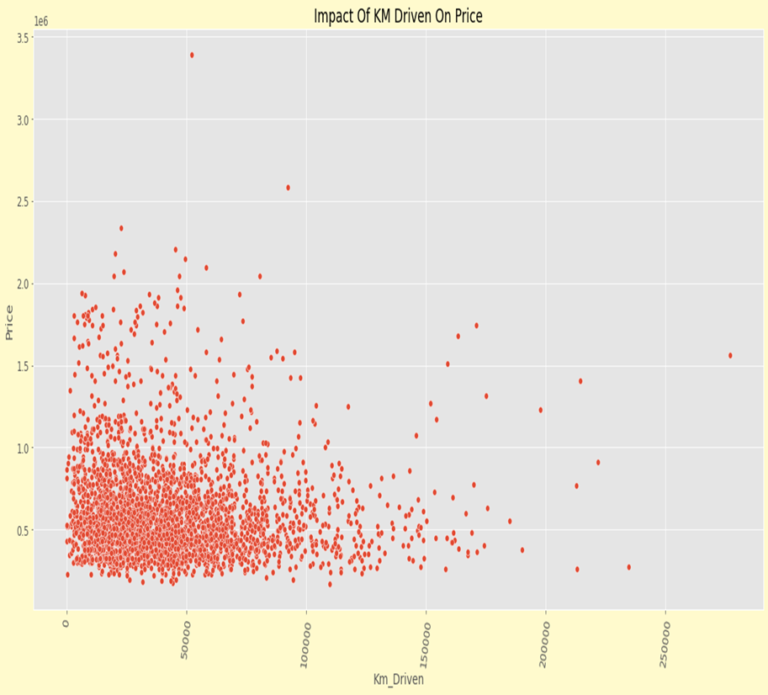
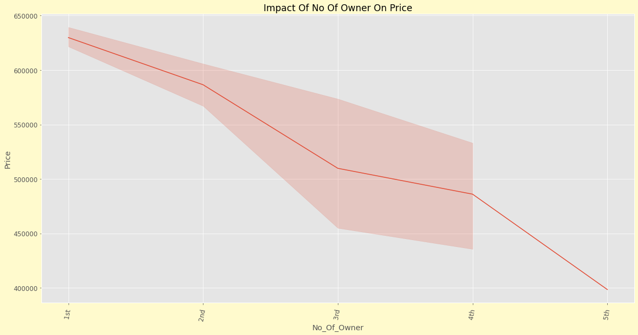
Mostly cars have ‘Km Driven’ between 0 to 10000 KM.
Cars ‘Price’ is high when the car has ‘No_Of_Owner’ as ‘1st owner’.

Slide 14
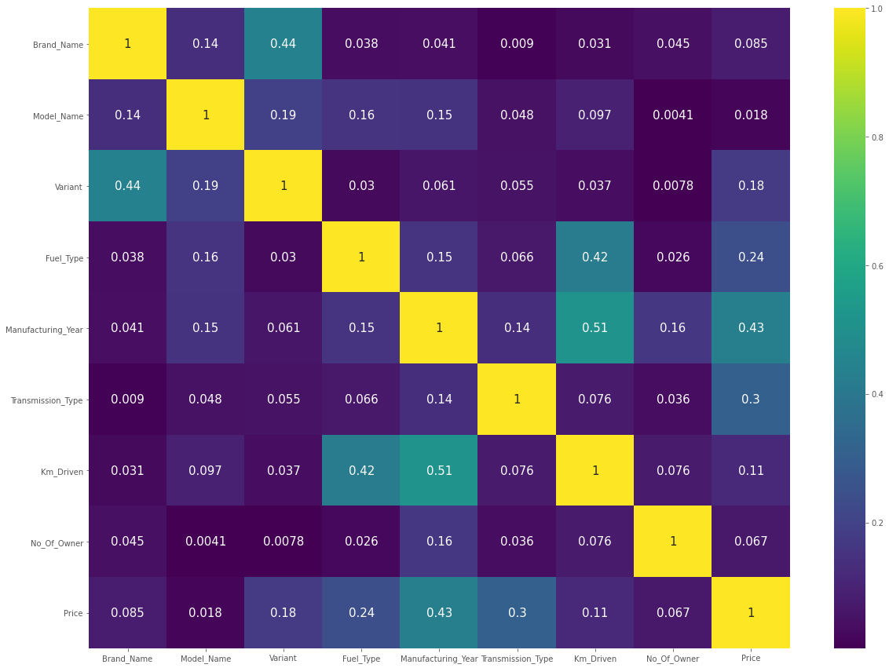
Correlation matrix using Heatmap
Features are not highly correlated.

Slide 15
Features Engineering
Dealing with Outliers
Using IQR and z-score method, the loss of data is 1.69%.
Dealing with Skewness
‘yeo-johnson’ method of Power Transformer is used to remove the skewness.
Encoding
‘Label encoder’ is used for encoding the object column.
Scaling the dataset
‘Standard Scaler’ is used to normalize the dataset.

Slide 16
Model Initiating
Find best Random State
Split dataset using Train_Test Split
Model Building
R2 Score
RMSE Score
Cross-Validation Score

Slide 17
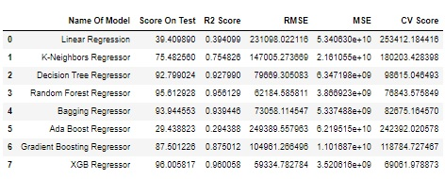
Scores of All Models
R2 score of Random Forest Regressor and XGB Regressor are also good. The RMSE score of XGB Regressor is less. Cross validation score is less for XGB Regressor as compared with Random Forest Regressor. So, XGB Regressor is final model on this dataset.

Slide 18
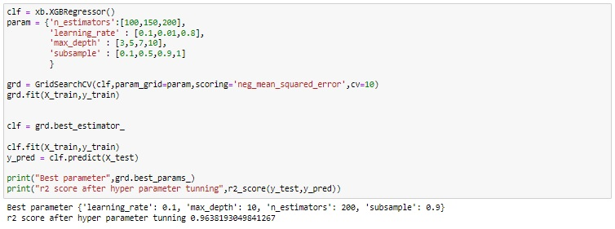
Hyperparameter Tuning
After hyperparameter tuning, I am able to improve the performance. So, using these best parameters we fitted the model and saved the model.

Slide 19
Conclusion
The ‘Price’ of cars are high when ‘fuel Type’ as ‘Diesel’, ‘Manufacturing Year’ as 2020, ‘Transmission Type’ as ‘Automatic’, ‘No Of Owner’ as ‘1st’.
Cars ‘Km Driven’ between 0 to 10000 are most in counting.
‘Mercedes’ car are most expensive cars.
‘Benz GLC Class’ model of ‘Mercedes’ are most expensive model.
I used total 8 algorithm to build the best model on this dataset.
Random Forest Regressor and XGB Regressor out of 8 model performed best on this dataset.
Comparing both models based on different metrics, XGB Regressor is final model on this dataset.
XGB Regressor gives 96.38% accurate prediction on test dataset.

Slide 20
Thank You………

